Slide 1

Of Activities, Intents and Applications
Copyright© Jeffrey Jongko, Ateneo de Manila University

Slide 2
Activities
Copyright© Jeffrey Jongko, Ateneo de Manila University

Slide 3
Overview
Application Fundamentals
Android Components
Activity
  Activity Life Cycle
  Intents
Application and Passing Data from Activity to Activity
Application Deployment and Management

Slide 4
Application Fundamentals
An android application is a set of compiled Java classes and resource files zipped together into a .apk file (Android package file)
  This is created using the IDE and “installed” into the emulator to run
Each Android application runs in its own Virtual Machine (its own little world)

Slide 5
Application Components
There are three main component types
  Activities – UI component
  Services – code that runs in the background
  BroadcastReceivers – code that listens for system events
We will be focusing on Activities

Slide 6
Activities
An activity presents a visual user interface for one focused endeavor the user can undertake.
  For example, an activity might present a list of menu items users can choose from or it might display photographs along with their captions.
  For example, A text messaging application might have one activity that shows a list of contacts to send messages to, a second activity to write the message to the chosen contact, and other activities to review old messages or change settings.

Slide 7
Activities
Though they work together to form a cohesive user interface, each activity is independent of the others.
Each one is implemented as a subclass of the Activity base class
The contents of an Activity are set using the setContentView() method
  A hierarchy of one or more View objects

Slide 8
Activity Life Cycle
Activities follow a specific life cycle controlled by the phone environment
Unused activities can be shutdown by the OS to release memory for use by other applications
  However, before the activity shuts down methods are available to provide a way to save data so they can be restored later

Slide 9
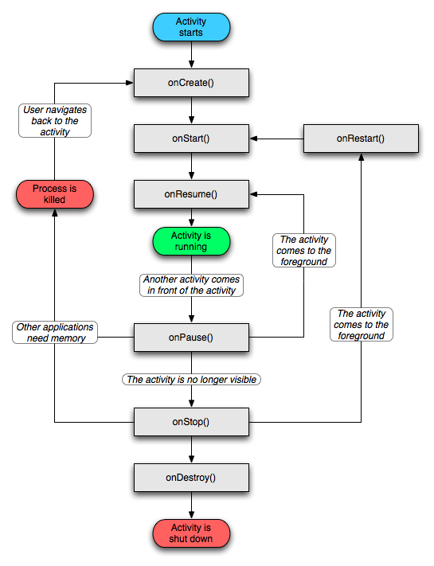
Activity Life Cycle

Slide 10
Life Cycle methods
These are the Activity life cycle methods
  void onCreate(Bundle savedInstanceState)
  void onStart()
  void onRestart()
  void onResume()
  void onPause()
  void onStop()
  void onDestroy()

Slide 11
onCreate()
Called when the activity is first created. This is where you should do all of your normal static set up — create views, bind data to lists, and so on.
This method is passed a Bundle object containing the activity's previous state, if that state was captured (see onSaveInstanceState(), later).
Always followed by onStart().

Slide 12
onStart()
Called just before the activity becomes visible to the user.
  Followed by onResume() if the activity comes to the foreground
  Followed by onStop() if it becomes hidden.

Slide 13
onRestart()
Called after the activity has been stopped, just prior to it being started again.
Always followed by onStart()

Slide 14
onResume()
Called just before the activity starts interacting with the user.
At this point the activity is at the top of the activity stack, with user input going to it.
  Always followed by onPause() when another activity takes over

Slide 15
onPause()
Called when the system is about to start resuming another activity.
This method is typically used to commit unsaved changes to persistent data, stop animations and other things that may be consuming CPU, and so on.
It should do whatever it does very quickly, because the next activity will not be resumed until it returns.

Slide 16
onPause()
Followed by onResume() if the activity returns back to the front
Followed by onStop() if it becomes invisible to the user

Slide 17
onStop()
Called when the activity is no longer visible to the user.
This may happen because it is being destroyed, or because another activity (either an existing one or a new one) has been resumed and is covering it.
Followed either by onRestart() if the activity is coming back to interact with the user, or by onDestroy() if this activity is going away

Slide 18
onDestroy()
Called before the activity is destroyed. This is the final call that the activity will receive. It could be called either because the activity is finishing (someone called finish() on it), or because the system is temporarily destroying this instance of the activity to save space.
You can distinguish between these two scenarios with the isFinishing() method.

Slide 19
Overriding lifecycle methods
An implementation of any activity lifecycle method should always first call the superclass version.
For example:
        protected void onPause()
        {
        super.onPause();
        // new stuff here
        }

Slide 20
onSaveInstanceState()
Remember onCreate() takes a Bundle parameter
This Bundle is generated using the onSaveInstanceState(Bundle)
  Note: this is not a life cycle method but simply a hook method that can be overridden
A Bundle is simply a name-value pair container similar in use to a Hashtable/Hashmap with extra convenience methods

Slide 21
Bundle
A Bundle is like a hashtable use to store name-value pairs
It contains several convenience methods to minimize the need to typecast the outbound result

Slide 22
Example
@Override
public void onSaveInstanceState(Bundle b)
{
b.putString("VALUE", "HERE I AM");
System.out.println("onSaveInstanceState()");
}
It contains several putXXX(String key, XXX value) method
Use eclipse auto-complete to see others

Slide 23
Demo
ActivityLifeCycle demo
Logcat – the new home of System.out.println() in Eclipse

Slide 24
Activities and Intents

Slide 25
Application Fundamentals
A central feature of Android is that one application potentially can make use of elements (e.g. activities) of other applications
For example, if your application needs to display a scrolling list of images and another application has developed a suitable scroller and made it available to others, you can call upon that scroller to do the work, rather than develop your own.
  E.g. the basic Gallery app

Slide 26
Application Fundamentals
Your application doesn't incorporate the code of the other application or link to it. Rather, it simply starts up that piece of the other application when the need arises.
You can activate the external program using Intents
This same mechanism is used to move from one activity to another within the same application

Slide 27
Intents
Intents are messages, a passive data structure holding an abstract description of an operation to be performed or, often in the case of broadcasts, a description of something that has happened and is being announced
Two types of intents
  Broadcast – goes to all running activities/services
  Explicit – targets a specific activity/service

Slide 28
Intent Filters
You can limit which intents can be received by your activities/services using an IntentFilter
The most common intent filter is the application launch intent filter
  Used to specify the entry point activity of your APK

Slide 29
Example
<application android:icon="@drawable/icon" android:label="@string/app_name">
<activity android:name=".HelloWorldActivity"
android:label="@string/app_name">
<intent-filter>
<action android:name="android.intent.action.MAIN" />
<category android:name="android.intent.category.LAUNCHER" />
</intent-filter>
</activity>
</application>
More system intents will be introduced later as needed, e.g. camera access

Slide 30
Triggering an Intent
The simplest kind of intent is explicit
To traverse to another Activity you cause use either of the following
  startActivity(Intent)
  startActivityForResult(Intent)
    This intent can also be used to communicate data between activities
      Like a return value (see later)

Slide 31
Creating and Using an Intent
Intent intent = new Intent(this, NextActivity.class);
intent.putExtra(key, value);
startActivity(intent);
An Intent is created using a new Intent() with two parameters
  Context – this is usually the current Activity
  Activity – this is the fully-qualified class name of the next Activity
    Next activity can get the intent using getIntent()
Intents can attach extra information using the putExtra(key, value) method
  This data will be available at the destination Activity

Slide 32
Copying all data from one intent to another
Intent has a putExtras(Intent) method
This will allow copying all the data of one intent to another
  Normally, you need to know the keys to copy intent data one at a time
  With this method you copy them all in one go

Slide 33
Activities and Intents
Every Activity has a getIntent() method
This returns the intent object that spawned the current activity

Slide 34
Data Flow
FORM 1
EditText1 (Name)
EditText2 (PhoneNumber)
BUTTON1 (Input Name)
BUTTON2 (Input #)
FORM 2
EditText3 (Address)
BUTTON1 (Done)
BUTTON2 (Cancel)
startActivity()
INTENT
FORM 3
TextView1 (Name)
TextView2 (PhoneNumber)
TextView3 (Address)
startActivity()
INTENT
INTENT
getIntent()
putExtras()

Slide 35
Using an Intent to return data
Some activities are meant to be used as a means to select information and return the selection
  E.g. a camera activity returns the picture taken
This selected information can be relayed back to the triggering activity
  setResult(int result code) – on the source activity
  onActivityResult(int requestCode, int resultCode, Intent data ) – on the receiver activity

Slide 36
Data Flow
FORM
TextView1 (Name)
TextView2(PhoneNumber)
BUTTON1 (Input Name)
BUTTON2 (Input #)
startActivityForResult()
INTENT
INPUT FORM
TextView (Label)
EditText (input field)
BUTTON1 (Done)
BUTTON2 (Cancel)
getIntent()
onActivityResult(requestCode,
resultCode, intent)
INTENT
NOTE: Ideally, you should use constants instead of hard-coded numbers to make sure your values are consistent

Slide 37
Intents
In order to use explicit intents the target activities must be present in the AndroidManifest.xml

Slide 38
Example
<application android:icon="@drawable/icon" android:label="@string/app_name">
<activity android:name=".IntentTestActivity"
android:label="@string/app_name">
<intent-filter>
<action android:name="android.intent.action.MAIN" />
<category android:name="android.intent.category.LAUNCHER" />
</intent-filter>
</activity>
<activity android:name=".IntentTestActivity2"
android:label="@string/app_name">
</activity>
</application>
NOTE the . before the activity class names

Slide 39
finish()
The finish() method is used to close an activity once you are done with it
Your activity will remain active until you call finish()
  If you do not finish an activity it will be placed in the activity stack when another activity is opened

Slide 40
Activity Stack
Android automatically manages an activity stack
Whenever new activities are opened if the previous activity’s finish() is not called it will be placed on this stack
When you press the BACK button the current activity will close and the previous put back on screen

Slide 41
Form Management
Copyright© Jeffrey Jongko, Ateneo de Manila University

Slide 42
Form Management
When making forms/activities it is required that you remember certain things such as
  If an activity may spawn one or more activities depending on the situation
    How do you know which one just happened?
  If data from the next activity is needed what do you do if the activity is canceled?
    Either through a button or hitting the BACK button

Slide 43
onActivityResult()
onActivityResult(int requestCode, int resultCode, Intent data) method triggers when the just closed activity is meant to return data to the current activity
It contains all the information needed to identify
  Which activity just closed
  The state the activity was in when closed
  The returned data itself

Slide 44
requestCode
When you call startActivityForResult(int requestCode, Intent intent)
  requestCode is a arbitrary integer representing what the next activity is
    0 could mean entering an activity to input a name
    1 could mean entering an activity to input an address

Slide 45
resultCode
When you call setResult(int resultCode, Intent data)
  resultCode is an arbitrary integer representing the exit state of the activity
    0 could mean OK
    1 could mean Cancel
This can be later used to determine later actions

Slide 46
Data Flow
FORM
TextView1 (Name)
TextView2(PhoneNumber)
BUTTON1 (Input Name)
BUTTON2 (Input #)
requestCode = 0
INPUT FORM
TextView (Label)
EditText (input field)
BUTTON1 (Done)
BUTTON2 (Cancel)
requestCode = 1
resultCode = 0
onActivityResult(requestCode,
resultCode, intent)
resultCode = 1
NOTE: Ideally, you should use constants instead of hard-coded numbers to make sure your values are consistent

Slide 47
BACK behaviour
The pressing the BACK cause the Activity to finish()
  This can be a problem if the previous activity is waiting for data
    E.g. the intent return will not have anything
The onBackPressed() method can be overridden to change this default behaviour
  i.e. allow adding of intent data, result info

Slide 48
Example
public void onBackPressed()
{
EditText b = (EditText) findViewById(R.id.editText1);
String text = b.getText().toString();
Intent data = getIntent();
data.putExtra("INPUT", text);
setResult(0, data);
super.onBackPressed();
}

Slide 49
Back-ing when expecting data
When you hit BACK on an activity that is supposed to return a result by default the result will be null
  i.e. The intent received on the onActivityResult() is null

Slide 50
Application

Slide 51
Activities
Activities are
  transient by nature – they come and go
  independent – they are not connected to each other
However, sometimes you need to share common data between activities
  You can define a central place which all your activities can access
    an Application

Slide 52
Manifest
You set the Application class used in the AndroidManifest.xml
All activities can get this class using the getApplication() method
  as always you will need to typecast the return value

Slide 53
Example
<application android:name=“admu.cs119.CustomApplication"
android:icon="@drawable/app_icon"
android:label="@string/app_name">
public void onCreate(Bundle savedInstanceState) {
super.onCreate(savedInstanceState);
setContentView(R.layout.main2);
CustomApplication app = (CustomApplication) getApplication();
// use here
}

Slide 54
Application
CustomApplication
getApplication()
Activity1
Activity2
Activity3
Since activities share the one common instance, you can use it to pass data between them as well
This will only work for Activities in the same application

Slide 55
Application Deployment

Slide 56
Overview
USB Debugging
Manual APK installation
Google Play

Slide 57
USB Debugging
Applications can be debugged on the device instead of the emulator
When debugging on device, the application is actually installed on the device
  You will see the application in the App Drawer

Slide 58
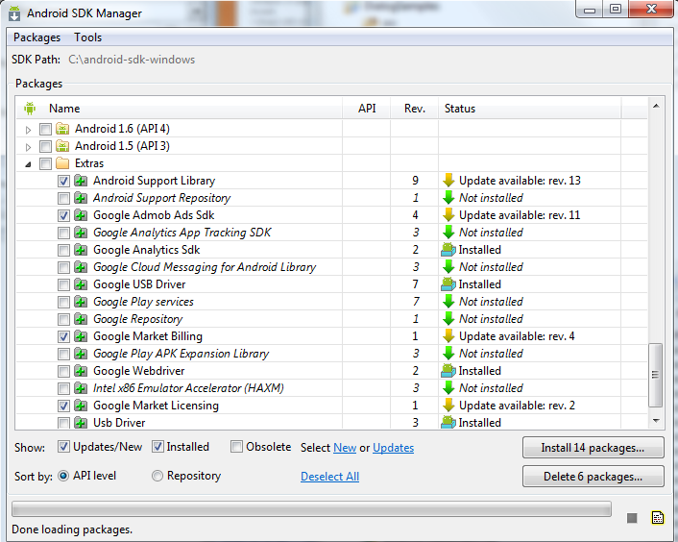
USB Debugging
Certain drivers need to be installed in Windows in order for USB Debugging to work
  Google USB Driver can be downloaded via the SDK Manager

Slide 59
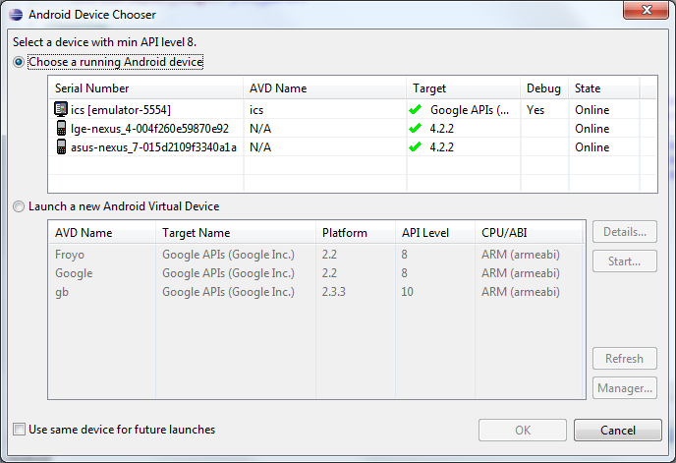
USB Debugging
Assuming the drivers are properly loaded, the devices should appear in the list of possible device targets

Slide 60
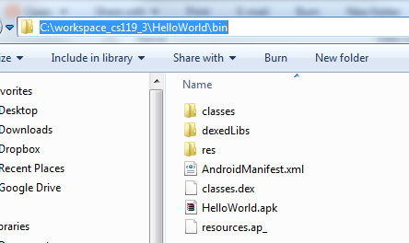
Manual APK Installation
Go to the /bin folder of your eclipse project
The .apk file inside can be copied to your phone
Use a file exploer on your phone, find the .apk and install

Slide 61

Google Play
None of the previous deployment strategies can be considered trusted
  They always come with a risk
  Manual deploy is ok for low quantities and controlled environments
The best way to deploy you app to a large audience is

Slide 62
Google Play
Setup an account on Google Play
  Costs $25 (one time fee)
Upload you app, fill out all the marketing requirements (e.g. screenshots, logos, spiels)
Define what phones it should work on
  You may deploy different .apk versions for different screens if you like
Once put up it usually takes a few hours before the world can see it

Slide 63
Application Management

Slide 64
It just won’t die
Sometimes Eclipse cannot install an application into the phone/emulator
To fix this, you will need to kill the process manually
One way around that is to delete the app from the phone/emulator
The process is exactly the same as if it was a real phone

Slide 65
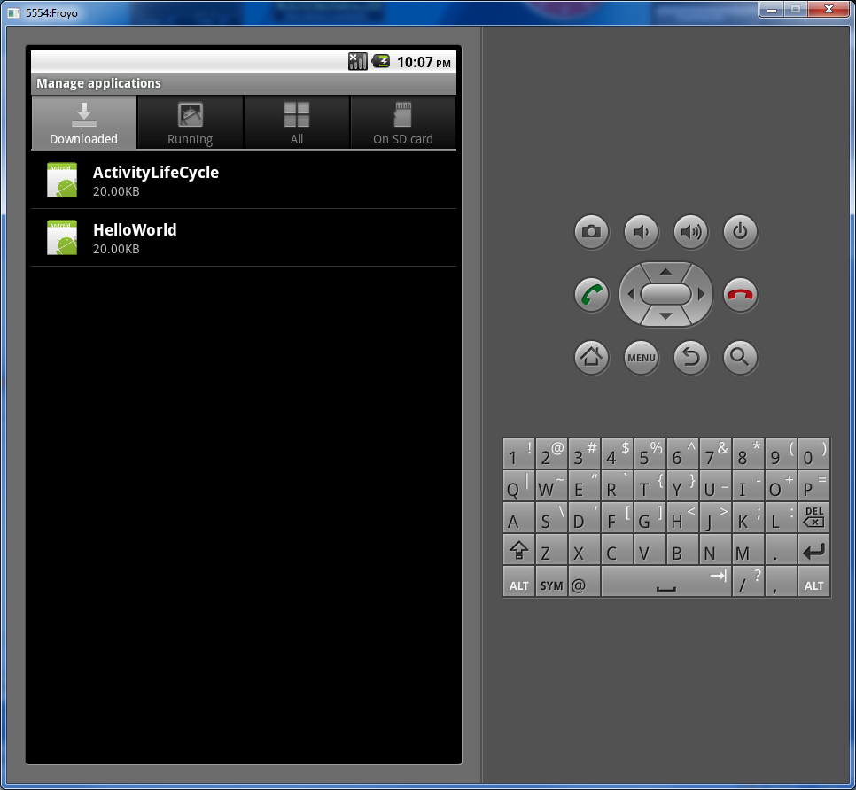
Application control menu
Settings -> Application Settings -> Manage applications

Slide 66
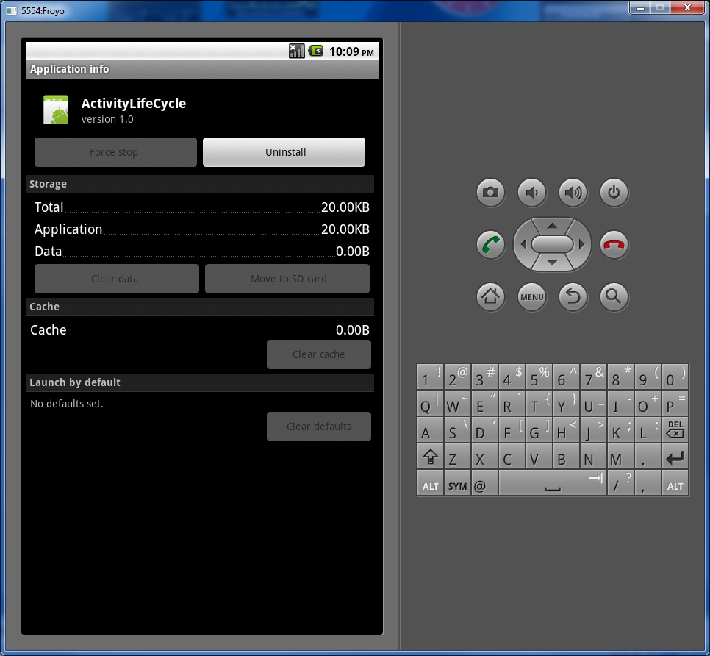
Application control Menu
From here you can manage the following
  Force close (FC)
  Uninstall
  Clear saved data

Slide 67
Coming soon
Advanced Layouts -- ScrollView/ViewFlipper
Dialogs -- DatePicker/TimePicker/Custom/Alert Builder
Data Management -- SharedPreferences/SQLLite
ListView/ListAdapter/CursorAdapter

